Slide 1




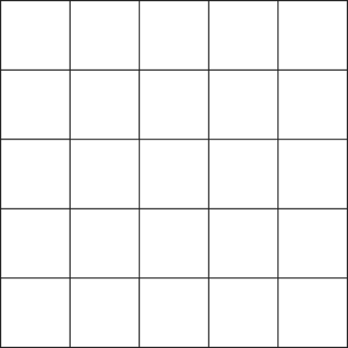

CSE 462
GRAPH
PARTITIONING
PROBLEM
1905064 - SAYEM SHAHAD
1905065 - ARNAB BHATTACHARJEE
1905079 - SALMAN SAYEED
1905089 - MAJISHA JAHAN DISHA
1905109 - ARKO SIKDER

Slide 2
CSE 462
02
03
01
REDUCTION FROM NP-HARD PROBLEM
APPROXIMATION AND MULTILEVEL ALGORITHMS
PROBLEM
DEFINITION
1905065
1905109
1905065
04
05
06
METAHEURISTICS ALGORITHMS
HEURISTICS ALGORITHMS
REAL-LIFE APPLICATIONS
1905089
1905064
1905079

Slide 3


CSE 462
BANGLADESH UNIVERSITY OF ENGINEERING AND TECHNOLOGY
01
PROBLEM
DEFINITION
1905065

Slide 4
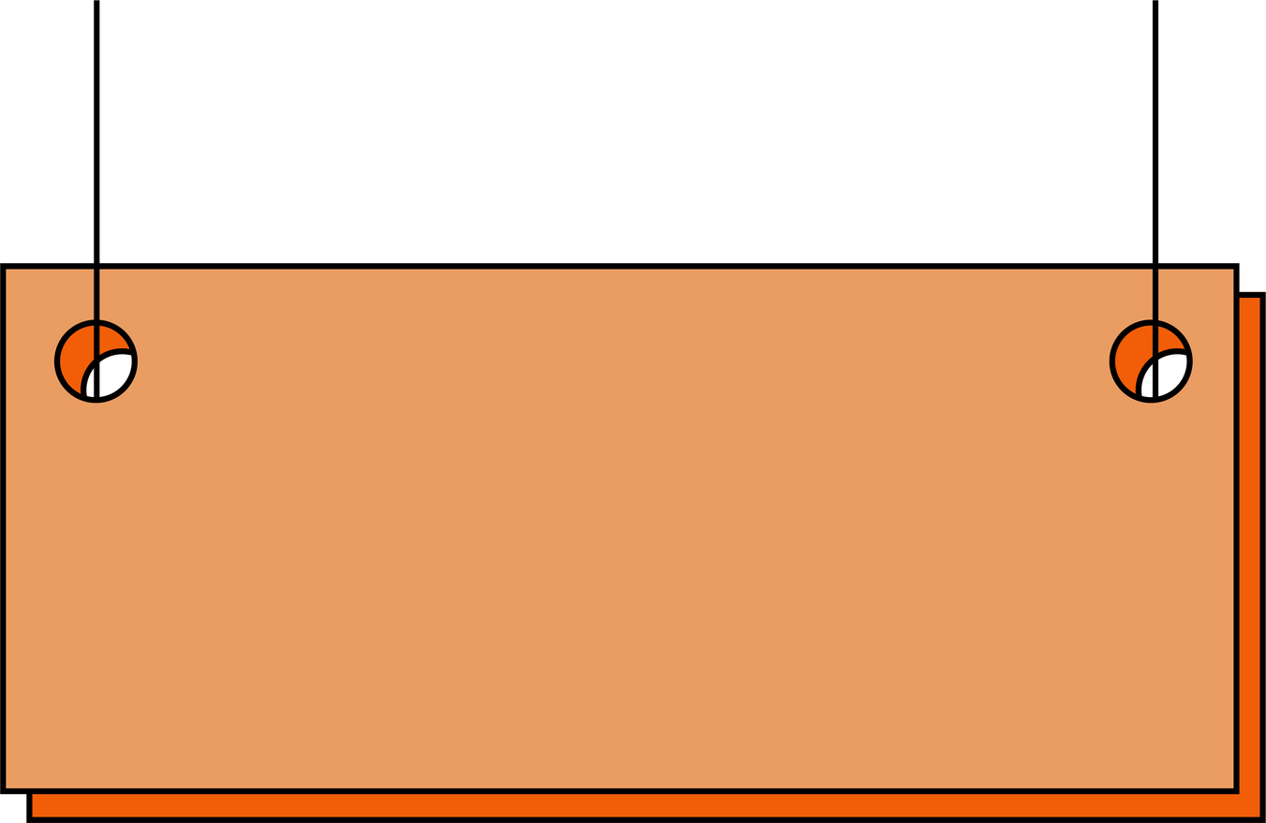




GRAPH PARTITION
BANGLADESH UNIVERSITY OF ENGINEERING AND TECHNOLOGY
DEFINITION
Reduction of a graph to a smaller graph by partitioning its set of nodes into mutually exclusive groups.
GRAPH PARTITIONING PROBLEM:
Tries to minimize the cut-size between partitions
P1
P2
C
E
F
Graph
Partitioning
Problem
A
G
B
D
Unbalanced
Partition
(Unconstrained)
H
I
r - Bound Partition
(Constrained)
CUT SIZE=3
J
Balanced
Partition
(Constrained)
P3

Slide 5
THE GRAPH PARTITION PROBLEM
BANGLADESH UNIVERSITY OF ENGINEERING AND TECHNOLOGY
STATEMENT
The Graph Partition Problem (GPP) is defined as follows:
C
E
Instance:
An undirected graph G = (V, E)
Number of desired partitions k ∈ ℕ
A
G
Optimization: Find a balanced partition of V into k subsets V₁, V₂, ..., Vₖ that minimizes cut(V₁, ..., Vₖ) = number of edges e crossing between partitions subject to:
∀i ∈ {1, ..., k}: |Vᵢ| ≤ 1 + ⌈|V|/k⌉ (balance constraint)
∪ᵢVᵢ = V (all vertices must be assigned)
Vᵢ ∩ Vⱼ = ∅ for i ≠ j (partitions are disjoint)
H
D
F
PARTITION 1
PARTITION 2
The Graph Partitioning Problem is NP-Hard for k ≥ 2, for both weighted and unweighted graphs.

Slide 6
CSE 462
BANGLADESH UNIVERSITY OF ENGINEERING AND TECHNOLOGY
02
Reduction from NP-Hard problem
1905065

Slide 7

NP - HARDNESS
BANGLADESH UNIVERSITY OF ENGINEERING AND TECHNOLOGY
GPP : NP - HARDNESS
Decision Version of the problem :
Given graph G=(V,E) and integer k, can we partition V into equal-sized sets with ≤ k edges between them?
The Optimization version of the problem is NP-Hard and the Decision version of the problem is NP-Complete.
We will prove the NP-Completeness of the Decision version of the problem

Slide 8
PROOF OF NP
BANGLADESH UNIVERSITY OF ENGINEERING AND TECHNOLOGY
GPP (DECISION VERSION): NP-COMPLETE
First, we need to prove that the decision version of GPP is in NP. It can be proved easily because:
Let’s assume a non-deterministic Turing Machine gives a “Yes” answer for GPP(G, k) instance, that is, for a graph G(V, E) and integer k, vertex set V has equal-sized partition sets with ≤ k edges between them.
It can be verified easily by counting the edges in the cuts (i.e., counting the edges that have two ends at two different partition set).
So, GPP_Decision ∈ NP
P1
P2
A
C
E
F
G
B
D
H
I
CUT SIZE = 3
J
P3

Slide 9
REDUCTION FROM NP - HARD
BANGLADESH UNIVERSITY OF ENGINEERING AND TECHNOLOGY
Reduction from Simple Max Cut
We show the reduction of the decision version of the Simple Max Cut Problem(which is a known NP-Hard problem) to the decision version of Graph Partition Problem.
Initial Problem (Simple Max Cut):
Input: Graph G=(V,E) and integer k
Question: Is there a set N such that
|{(v′,v′′)∈E|v′∈N∧v′′∈V∖N}| ≥ k
In other words, can we partition vertices into two sets where the number of edges between them is ≥ k?
Target Problem (Graph Partitioning Problem):
Input: Graph G*=(V*,E*) and integer k*
Question: Can we partition V into equal-sized sets with ≤ k edges between them?

Slide 10
REDUCTION FROM NP - HARD
BANGLADESH UNIVERSITY OF ENGINEERING AND TECHNOLOGY
Reduction from Simple Max Cut
The Reduction Construction: From a Simple Max Cut instance (V,E,k), we create a Graph Partition instance (V*,E*,k*):
V* = V ∪ {u₁,...,uₙ} // Add n new vertices to original vertex set
E* = {(v′,v′′) ∈ V* × V* | (v′,v′′) ∉ E} // Complement of original edges
k* = n² - k // New target is complement of original target
Join all possible edges from both side except the dotted blue ones, they are omitted in G*
V’
V’’
A1
A3
A1
A3
U3
U1
A2
A4
G
U2
A2
A4
U4
G*

Slide 11
REDUCTION FROM NP - HARD
BANGLADESH UNIVERSITY OF ENGINEERING AND TECHNOLOGY
Reduction from Simple Max Cut
Join all possible edges from both side except the dotted blue ones, they are omitted in G*
A1
A3
A1
A3
U3
U1
A2
A4
U2
A2
A4
U4
G(V,E)
(Instance for Max Cut)
G*(V*,E*)
(Instance for Graph Partition)
V* = V ∪ {u₁,...,uₙ} // Add n new vertices to original vertex set
E* = {(v′,v′′) ∈ V* × V* | (v′,v′′) ∉ E} // Complement of original edges
k* = n² - k // New target is complement of original target

Slide 12

REDUCTION FROM NP - HARD
BANGLADESH UNIVERSITY OF ENGINEERING AND TECHNOLOGY
Reduction from Simple Max Cut
Partitions:
In Simple Max Cut:
If G has Max-Cut solution, then:
V′ and V′′ are the two parts that partition V
We want | edges between V′ and V′′ | ≥ k
V’
V’’
A1
A3
A2
A4
G

Slide 13
BANGLADESH UNIVERSITY OF ENGINEERING AND TECHNOLOGY
REDUCTION FROM NP - HARD
Reduction from Simple Max Cut
Partitions:
Join all possible edges from both side except the dotted blue ones, they are omitted in G*
In Graph Partition, the solution generates such as:
W′ = V′ ∪ {u₁,...,uj} where j = n-|V′|
W′′ = V* \ W ’ (means, all remaining vertices of V*)
W′ and W′′ are the two equal-sized parts that partition V*, means: V* = W’ ∪ W’’ and
|W′|=|W′′|=n and u ∈W′, u ∈W′′
We want | edges between W′ and W′′ | ≤ k*
W’
W’’
A1
A3
U3
U1
1
n
U2
A2
A4
U4
G*

Slide 14
REDUCTION FROM NP - HARD
BANGLADESH UNIVERSITY OF ENGINEERING AND TECHNOLOGY
Proof of Correctness
(G, k) belongs to Simple_Max_Cut iff (G*, k*) belongs to GPP
Simple_Max_Cut -> GPP:
V’
V’’
A1
A3
Suppose, Simple_Max_Cut(G, k) has “Yes” solution. That means V has a partition where vertex sets V’ and V’’ have at least k edges between them.
As a result, for the GPP instance, GPP(G*, k*), will have a “Yes” solution, because:
A2
A4
G
edges in E* between W′,W′′ = n² - edges in E between V′,V′′
=n²− | {(v′,v′′)∈E| v′∈V′∧v′′∈V′′} |
≤ n² - k
= k*
W’
W’’
A1
A3
U3
U1
U2
A2
A4
U4
And sizes of W’ and W’’ are equal.
G*

Slide 15
REDUCTION FROM NP - HARD
BANGLADESH UNIVERSITY OF ENGINEERING AND TECHNOLOGY
Proof of Correctness
(G, k) belongs to Simple_Max_Cut iff (G*, k*) belongs to GPP
GPP -> Simple_Max_Cut:
W’
W’’
A1
A3
U3
Suppose, GPP(G*, k*) has “Yes” solution. That means V* has a partition where 2 equal-sized vertex sets W’ and W’’ have at most k* edges between them.
As a result, for the Simple_Max_Cut instance, Simple_Max_Cut(G, k) will have a “Yes” solution, because:
U1
U2
A2
A4
U4
G*
edges in E between V′,V′′ = n² - edges in E* between W′,W′′
= n² - | {(v′,v′′)∈E∗|v′∈W′∧v′′∈W′′} |
≥ n² - k*
= n² - (n² - k)
= k
V’
V’’
A1
A3
A2
A4
G

Slide 16

CSE 462
BANGLADESH UNIVERSITY OF ENGINEERING AND TECHNOLOGY
03
APPROXIMATION
& MULTILEVEL
ALGORITHMS
1905109

Slide 17


APPROXIMATION ALGORITHM
One of the most popular approximation algorithms for Graph Partitioning
Based on Fiedler Vector
Spectral
Partitioning
7
8
9
Fiedler Vector
The second smallest eigenvalue of the Laplacian matrix is called the algebraic connectivity of a graph, and its corresponding eigenvector is known as the Fiedler vector.
4
5
6
1
2
3

Slide 18
APPROXIMATION ALGORITHM
7
8
9
INPUT GRAPH
4
5
6
Laplacian Matrix
1
2
3
The Laplacian matrix L(G) of a graph G = (V, E) is a |V| x |V| symmetric matrix with one row and one column for each vertex and the entries of the matrix is defined as follows:
L(i, i) = degree of node i
L(i, j) = -1 if i ≠ j and there is an edge (i, j)
L(i, j) = 0, otherwise
2 -1 0 -1 0 0 0 0 0
-1 3 -1 0 -1 0 0 0 0
0 -1 2 0 0 -1 0 0 0
-1 0 0 3 -1 0 -1 0 0
0 -1 0 -1 4 -1 0 -1 0
0 0 -1 0 -1 3 0 0 -1
0 0 0 -1 0 0 2 -1 0
0 0 0 0 -1 0 -1 3 -1
0 0 0 0 0 -1 0 -1 2
LAPLACIAN MATRIX
Spectral
Partitioning

Slide 19
APPROXIMATION ALGORITHM
7
8
9
INPUT GRAPH
4
5
6
Algorithm
1
2
3
Construct the Laplacian matrix L(G) for the input graph G = (V, E)
Compute the eigenvector corresponding to the second eigenvalue
of the Laplacian matrix L(G)
For each vertex i ∈ V,
if [i] < 0 put vertex i in partition V(-)
else put vertex i in partition V(+)
2 -1 0 -1 0 0 0 0 0
-1 3 -1 0 -1 0 0 0 0
0 -1 2 0 0 -1 0 0 0
-1 0 0 3 -1 0 -1 0 0
0 -1 0 -1 4 -1 0 -1 0
0 0 -1 0 -1 3 0 0 -1
0 0 0 -1 0 0 2 -1 0
0 0 0 0 -1 0 -1 3 -1
0 0 0 0 0 -1 0 -1 2
LAPLACIAN MATRIX
Spectral
Partitioning

Slide 20
APPROXIMATION ALGORITHM
7
8
9
INPUT GRAPH
4
5
6
1
2
3
In our example,
Second Eigenvalue, = 0.9999999999999973
Fiedler Vector, = [0.5767, 0.2742, −0.0283, 0.3025, 4.2476×10−16, −0.3025, 0.0283, −0.2742, −0.5767]
Here, Cut Size = 4
1
3
2
6
4
PARTITIONS
8
5
9
7
Spectral
Partitioning

Slide 21

APPROXIMATION ALGORITHM
7
8
9
INPUT GRAPH
4
5
6
Approximation Factor
1
2
3
Spectral Partitioning can be characterized as a -approximation algorithm based on this paper.
where, d is the maximum vertex degree.
The factor can be quite low based on different graph classes.
1
3
2
6
PARTITIONS
4
8
5
9
7
Spectral
Partitioning

Slide 22
MULTILEVEL ALGORITHM
One of the most widely used algorithms for Graph Partitioning
Based on 3 simple steps
Multilevel Graph Partitioning
3
4
5
6
Coarsening Phase
Initial Partitioning
Uncoarsening and Refinement
1
2
7
8

Slide 23
MULTILEVEL ALGORITHM
3
4
5
6
Coarsening Phase
INPUT GRAPH
The graph is repeatedly coarsened (reduced in size) by collapsing pairs of adjacent vertices (randomly chosen), until the graph is small enough to be easily partitioned.
1
2
7
8
1,2,3
7,8
In our example, we merge the following vertices-
1, 2, 3
4, 5
7, 8
COARSENED GRAPH
4,5
6
Multilevel Graph Partitioning

Slide 24
MULTILEVEL ALGORITHM
3
4
5
6
Initial Partitioning
INPUT GRAPH
A relatively faster algorithm is applied that provides a rough partition of the smaller graph.
1
2
7
8
1,2,3
7,8
COARSENED GRAPH
4,5
6
In our example, let’s assume our chosen algorithm to provide a partition of-
{1,2,3 and 6}
{7,8 and 4,5}
1,2,3
7,8
6
4,5
PARTITIONED GRAPH
Multilevel Graph Partitioning

Slide 25
MULTILEVEL ALGORITHM
Uncoarsening and Refinement
3
4
5
6
The graph is uncoarsened by gradually expanding back to its original size. At each level of uncoarsening, the partition is refined using local improvement methods such as Kernighan-Lin(KL)* or Fiduccia-Mattheyes(FM)* to further minimize the cut size.
*KL and FM to be explained later
INPUT GRAPH
1
2
7
8
1
4
2
5
3
7
UNCOARSENED GRAPH
In our example,
Cut size in uncoarsened graph is 4
We can use the refinement algorithms to minimize the cut size while maintaining balance.
6
8
Multilevel Graph Partitioning

Slide 26
MULTILEVEL ALGORITHM
Uncoarsening and Refinement
3
4
5
6
The graph is uncoarsened by gradually expanding back to its original size. At each level of uncoarsening, the partition is refined using local improvement methods such as Kernighan-Lin(KL)* or Fiduccia-Mattheyes(FM)* to further minimize the cut size.
*KL and FM to be explained later
INPUT GRAPH
1
2
7
8
1
5
2
6
3
7
UNCOARSENED AND REFINED GRAPH
In our example,
Refining in each level of uncoarsening, we can use the algorithms that might move 6 to the right set and 4 to the left set, resulting in a cut size of only 1.
4
8
Multilevel Graph Partitioning

Slide 27
GENERAL ALGORITHMS
Randomized Greedy Algorithm
Some
General
Algorithms
Branch and Bound
Integer Linear Programming

Slide 28
CSE 462
BANGLADESH UNIVERSITY OF ENGINEERING AND TECHNOLOGY
04
METAHEURISTIC
ALGORITHMS
1905089

Slide 29
METAHEURISTIC ALGORITHM
Simmulated Annealing
1. INITIAL SOLUTION:
D
RANDOM PARTITION:
{A,E}, {C,F},{B,D}
B
E
F
A
C

Slide 30
METAHEURISTIC ALGORITHM
Simmulated Annealing
2. NEIGHBORHOOD EXPLORATION:
D
D
B
E
B
E
F
F
A
A
C
C
NEIGHBOR 1:
NEIGHBOR 2:
{A,C}, {E,F},{B,D}
{A,B}, {C,F},{E,D}

Slide 31

METAHEURISTIC ALGORITHM
Simmulated Annealing
3. ACCEPTANCE CRITERIA:
WITH LOW PROBABILITY
D
D
B
E
B
E
F
F
A
A
C
C
NEIGHBOR 1:
NEIGHBOR 2:
{A,C}, {E,F},{B,D}
{A,B}, {C,F},{E,D}

Slide 32
METAHEURISTIC ALGORITHM
Simmulated Annealing
4. COOLING SCHEDULE:
GRADUALLY LOWER THE PROBABILITY OF ACCEPTING WORSE SOLUTIONS BY REDUCING THE TEMPERATURE OVER TIME.
D
B
E
5. FINAL SOLUTION:
AFTER MANY ITERATIONS AND AS THE TEMPERATURE APPROACHES ZERO, THE ALGORITHM CONVERGES TO A SOLUTION THAT IS (HOPEFULLY) NEAR THE GLOBAL OPTIMUM
F
A
C
PARTITION:
{A,C}, {E,F},{B,D}
ADVANTAGE: ABILITY TO ESCAPE LOCAL MINIMA AND POTENTIALLY FIND MORE OPTIMAL GLOBAL SOLUTIONS,
DISADVANTAGE: SLOWER

Slide 33
METAHEURISTIC ALGORITHM
Genetic Algorithm:
D
B
E
1. INITIALIZATION:
START WITH A POPULATION OF POTENTIAL SOLUTIONS, EACH REPRESENTING A POSSIBLE WAY TO PARTITION THE GRAPH.
F
A
VERTEX ENCODING:
C
A gene cORRESPONDS TO A VERTEX.
IT ASSIGNS EACH GENE A SPECIFIED NUMBER 0 TO K DEPENDING ON WHICH PARTITION THE GENE BELONGS TO.
RANDOM PARTITION:
{A,E}, {C,F},{B,D}
VERTEX ENCODING HERE IS : 132312

Slide 34
METAHEURISTIC ALGORITHM
Genetic Algorithm:
2. FITNESS FUNCTION:
MORE CUT EDGES
LESS CUT EDGES
D
D
E
B
E
B
F
F
A
A
C
C
RANDOM PARTITION:
{A,E}, {C,F},{B,D}
RANDOM PARTITION:
{A,B}, {C,F},{E,D}
VERTEX ENCODING : 132312
VERTEX ENCODING : 112332

Slide 35
METAHEURISTIC ALGORITHM
Genetic Algorithm:
3. PARENTS SELECTION AND THEIR ENCODING:
PARENT 1:
PARENT 2:
D
D
E
B
E
B
F
F
A
A
C
C
RANDOM PARTITION:
{A,E}, {C,F},{B,D}
RANDOM PARTITION:
{A,B}, {C,F},{E,D}
VERTEX ENCODING : 132312
VERTEX ENCODING : 112332

Slide 36


PARENT 1:
METAHEURISTIC ALGORITHM
Genetic Algorithm:
PENALTY
4. CROSSOVER:
PARENT 1 : 132312
CHILD 1 : 132332
PARENT 2 : 112332
CHILD2: 112332
5. MUTATION:
D
D
E
B
E
B
F
F
A
A
C
C
112233
112332

Slide 37
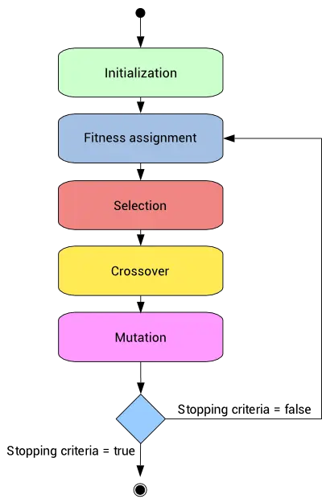
PARENT 1:
METAHEURISTIC ALGORITHM
Genetic Algorithm:
6. TERMINATION:
ADVANTAGE: USES GLOBAL SEARCH, EASY TO ADD CONSTRAINS
DISADVANTAGE: SLOW CONVERGENCE, HIGH COMPUTATIONAL COST

Slide 38
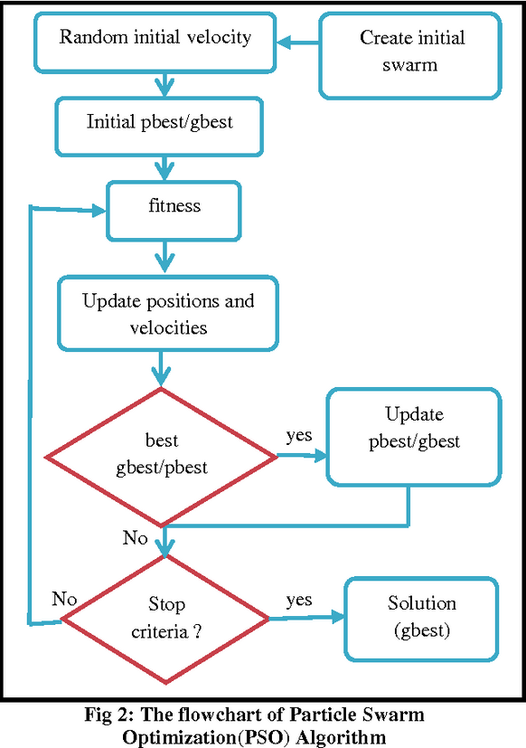
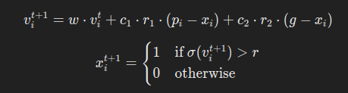
METAHEURISTIC ALGORITHM
Discrete Particle Swarm Optimization (DPSO)
INITIALIZATION:
Randomly generate particles, each as a binary vector representing a potential solution.
Velocity and Position Update:
Update velOCITY USING PERSONAL AND GLOBAL BEST POSITIONS, THEN UPDATE POSITION BASED ON A SIGMOID FUNCTION:
FITNESS EVALUATION
UPDATE PERSONAL AND GLOBAL BEST:
UPDATE THE PARTICLE’S PERSONAL BEST AND GLOBAL BEST IF THE CURRENT SOLUTION IS BETTER.
TERMINATION

Slide 39
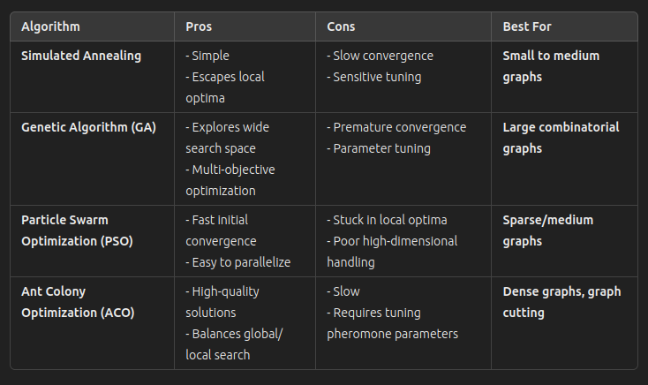
METAHEURISTIC ALGORITHM
ALL METAHEURISTIC ALGORITHMS:

Slide 40
CSE 462
BANGLADESH UNIVERSITY OF ENGINEERING AND TECHNOLOGY
05
HEURISTIC
ALGORITHMS
1905064-Sayem Shahad

Slide 41
HEURISTIC ALGORITHMS
BANGLADESH UNIVERSITY OF ENGINEERING AND TECHNOLOGY
KERNIGHAN-LIN (KL)
ALGORITHM
=>DIVIDES THE GRAPH INTO TWO BALANCED PARTITION

Slide 42
HEURISTIC ALGORITHMS
BANGLADESH UNIVERSITY OF ENGINEERING AND TECHNOLOGY
C
E
G
A
H
B
D
F
PARTITION 1
PARTITION 2
A RANDOM PARTITION => (A,B,C,D),(E,F,G,H)

Slide 43
HEURISTIC ALGORITHMS
BANGLADESH UNIVERSITY OF ENGINEERING AND TECHNOLOGY
E
C
G
A
H
B
D
F
FOR VERTEX E,
EXTERNAL EDGES = EC, EB
INTERNAL EDGES = EF

Slide 44
HEURISTIC ALGORITHMS
BANGLADESH UNIVERSITY OF ENGINEERING AND TECHNOLOGY
E
C
G
A
if E is moved to another partition, how much the cut will be reduced
H
B
D
F
GAIN(E) = # OF EXTERNAL EDGES - # OF INTERNAL EDGES
= 1

Slide 45
HEURISTIC ALGORITHMS
BANGLADESH UNIVERSITY OF ENGINEERING AND TECHNOLOGY
FOR PARTITION 1 ,
FOR PARTITION 2 ,
C
E
A
G
GAIN(A) = -2
GAIN(B) = -1
GAIN(C) = -2
GAIN(D) = 0
GAIN(E) = 1
GAIN(F) = -2
GAIN(G) = -2
GAIN(H) = -2
B
H
D
F
PARTITION 1
PARTITION 2

Slide 46

WHICH PAIR TO SWAP ?
IF THERE IS A NODE PAIR ( V1 ,V2 ) SUCH THAT V1 ∈ P1 AND V2 ∈ P2,
WE CAN SWAP THEM IF :
1, if there is an edge
between V1 and V2
1) G = GAIN(V1) + GAIN (V2) - 2* W(V1,V2)
IS MAXIMUM AMONG ALL PAIRS
W(V1,V2) =
0 otherwise
2) G = GAIN(V1) + GAIN (V2)
IS MAXIMUM AMONG ALL PAIRS

Slide 47

HEURISTIC ALGORITHMS
BANGLADESH UNIVERSITY OF ENGINEERING AND TECHNOLOGY
C
E
C
G
SWAP AND LOCK
D
A
G
A
B
H
B
H
E
F
D
F
PARTITION 1
PARTITION 2
PARTITION 1
PARTITION 2
UPDATE THE MIN CUT

Slide 48
HEURISTIC ALGORITHMS
BANGLADESH UNIVERSITY OF ENGINEERING AND TECHNOLOGY
GAIN CALCULATION
CHOOSE PAIR
CONTINUE UNTIL ALL NODES ARE LOCKED
SWAP AND LOCK
UPDATE MIN CUT

Slide 49
HEURISTIC ALGORITHMS
BANGLADESH UNIVERSITY OF ENGINEERING AND TECHNOLOGY
FIDUCCIA-MATTHEYSES (FM)
ALGORITHM
=>EFFICIENT GAIN UPDATE

Slide 50
HEURISTIC ALGORITHMS
BANGLADESH UNIVERSITY OF ENGINEERING AND TECHNOLOGY
AN OBSERVATION.......

Slide 51
HEURISTIC ALGORITHMS
BANGLADESH UNIVERSITY OF ENGINEERING AND TECHNOLOGY
C
E
C
G
A
G
A
H
MOVE E
B
E
H
B
D
F
D
F
PARTITION 1
PARTITION 2
PARTITION 1
PARTITION 2

Slide 52
HEURISTIC ALGORITHMS
BANGLADESH UNIVERSITY OF ENGINEERING AND TECHNOLOGY
C
E
C
G
A
G
A
H
MOVE E
B
E
H
B
D
F
D
F
PARTITION 1
PARTITION 2
PARTITION 1
PARTITION 2
only gains of E’s neighbors changes!!!!

Slide 53
HEURISTIC ALGORITHMS
BANGLADESH UNIVERSITY OF ENGINEERING AND TECHNOLOGY
C
E
C
G
A
G
A
H
MOVE E
B
E
H
B
D
F
D
F
PARTITION 1
PARTITION 2
PARTITION 1
PARTITION 2
only gains of E’s neighbors changes!!!!
for B and C, gain decreases by 2
for F, gain increases by 2

Slide 54
HEURISTIC ALGORITHMS
BANGLADESH UNIVERSITY OF ENGINEERING AND TECHNOLOGY
FM ALGORITHM:
1) MOVE A VERTEX INSTEAD OF SWAPPING A PAIR
2) EFFICIENT GAIN UPDATE

Slide 55
HEURISTIC ALGORITHMS
BANGLADESH UNIVERSITY OF ENGINEERING AND TECHNOLOGY
C
E
G
A
H
B
D
F
PARTITION 1
PARTITION 2
A RANDOM PARTITION => (A,B,C,D),(E,F,G,H)

Slide 56
HEURISTIC ALGORITHMS
BANGLADESH UNIVERSITY OF ENGINEERING AND TECHNOLOGY
C
E
FOR PARTITION 1 ,
FOR PARTITION 2 ,
G
A
GAIN(A) = 0
GAIN(B) = 1
GAIN(C) = -1
GAIN(D) = 0
GAIN(E) = 1
GAIN(F) = -1
GAIN(G) = -1
GAIN(H) = 1
B
H
D
F
PARTITION 1
PARTITION 2

Slide 57


HEURISTIC ALGORITHMS
BANGLADESH UNIVERSITY OF ENGINEERING AND TECHNOLOGY
GAINS FOR PARTITION 1
GAINS FOR PARTITION 2
E has the maximal gain.
let’s move it
to partition 1 !!!
2
2
1
B
1
E
H
0
A
D
0
-1
C
-1
F
G
C
E
A
G
B
H
D
F
PARTITION 1
PARTITION 2

Slide 58

HEURISTIC ALGORITHMS
BANGLADESH UNIVERSITY OF ENGINEERING AND TECHNOLOGY
GAINS FOR PARTITION 1
GAINS FOR PARTITION 2
E has the maximal gain.
let’s move it
to partition 1 !!!
2
2
1
B
1
E
H
0
A
D
0
-1
C
-1
F
G
B
C
F
C
E
A
G
VERTEX LIST FOR FASTER ACCESS TO NEIGHBOR NODES
B
H
D
F
PARTITION 1
PARTITION 2

Slide 59
HEURISTIC ALGORITHMS
BANGLADESH UNIVERSITY OF ENGINEERING AND TECHNOLOGY
GLOBAL KL REFINEMENT (GKLR)
ALGORITHM
=>MULTIWAY PARTITIONING

Slide 60
HEURISTIC ALGORITHMS
BANGLADESH UNIVERSITY OF ENGINEERING AND TECHNOLOGY
C
E
A
F
G
D
B
H
I
J

Slide 61
HEURISTIC ALGORITHMS
BANGLADESH UNIVERSITY OF ENGINEERING AND TECHNOLOGY
P1
P2
C
E
A
F
G
D
B
H
I
CUT SIZE=4
J
P3

Slide 62
HEURISTIC ALGORITHMS
BANGLADESH UNIVERSITY OF ENGINEERING AND TECHNOLOGY
GAINS TABLE
P1
2
I
E
P2
A
C
F
1
E
0
B
G
G
-1
D
C
J
B
D
-2
A
H
F
H
I
-3
CUT SIZE=4
J
P3

Slide 63
HEURISTIC ALGORITHMS
BANGLADESH UNIVERSITY OF ENGINEERING AND TECHNOLOGY
WHICH PARTITION IS OPTIMAL TO MOVE
P1
E
P2
A
C
F
NODE ‘I’ HAS,
TWO EXTERNAL EDGES TO PARTITION P2
ONE EXTERNAL EDGE TO PARTITION P1
G
B
D
H
I
CUT SIZE=4
P2 IS THE OPTIMAL ONE
J
P3

Slide 64
HEURISTIC ALGORITHMS
BANGLADESH UNIVERSITY OF ENGINEERING AND TECHNOLOGY
P1
E
P2
C
F
A
I
G
D
B
H
CUT SIZE=3
J
P3

Slide 65
HEURISTIC ALGORITHMS
BANGLADESH UNIVERSITY OF ENGINEERING AND TECHNOLOGY
Hendrickson - Leland algorithm | uses FM algorithm for k-way partitioning uses k(k-1) gain tables used when k is low
Walshaw-Cross refinement algorithm | almost the same as GKLR Uses load distribution algorithms for better balancing

Slide 66
CSE 462
BANGLADESH UNIVERSITY OF ENGINEERING AND TECHNOLOGY
06
REAL-LIFE APPLICATIONS
1905079

Slide 67
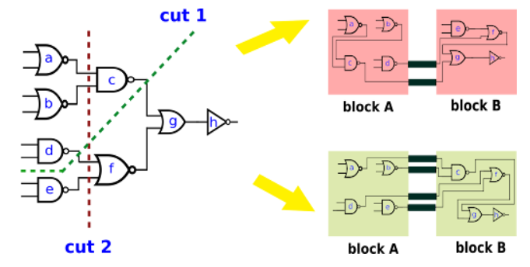
VLSI DESIGN:
Circuit Partitioning
The goal is to divide a large circuit into smaller, more manageable sub-circuits while minimizing the number of connections between partitions to reduce complexity and optimize performance.
Circuit components (like gates, modules, flip-flops) are represented as vertices in the graph, while the wires connecting them are represented as edges.
Balanced Partitioning: Each partition should contain approximately equal numbers of components to ensure even distribution of computational load and area utilization.
Minimizing Cut Size: The objective is to minimize the number of edges (interconnections) that cross between different partitions, which directly impacts:
Power consumption
Signal delay
Routing complexity
Manufacturing cost

Slide 68
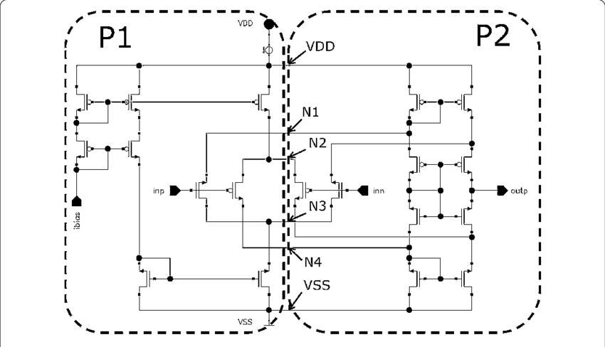
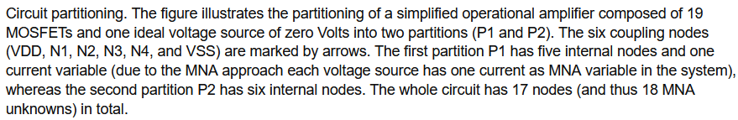
VLSI DESIGN:
Multi-level Circuit Partitioning:
Complex VLSI circuits are partitioned hierarchically:
System level: Dividing into major functional blocks
Block level: Breaking down functional blocks into smaller modules
Gate level: Organizing individual gates and components
Chip Floorplanning
The objective is to arrange circuit modules on a chip while optimizing area utilization and minimizing wire length
Each partition must consider power distribution, thermal constraints, and signal timing requirements
The partitioning solution affects the overall chip performance and manufacturing yield
Physical Design Optimization
Aims to minimize critical path delays and power consumption through optimal component placement
Partitions must balance computational load while maintaining signal integrity
Consider physical constraints like heat dissipation and power distribution networks

Slide 69

PARALLEL COMPUTING:
1. Load Balancing in Distributed Systems
How Graph Partitioning is Used: Distributes workload evenly across multiple computing nodes while minimizing the communication overhead between nodes. The system's tasks and their dependencies are modeled as a graph, where balanced partitions ensure efficient resource utilization.
Example: Apache Hadoop uses graph partitioning techniques to distribute large-scale data processing tasks across a cluster, ensuring each node receives a balanced portion of the MapReduce operations while minimizing data transfer between nodes.

Slide 70
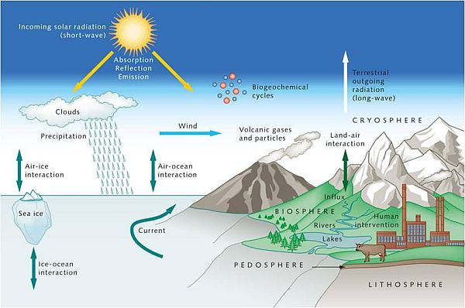
PARALLEL COMPUTING:
2. Simulation Distribution
How Graph Partitioning is Used: Divides large scientific computation tasks into balanced subtasks that can be processed simultaneously across multiple processors while minimizing inter-processor communication. The computation is represented as a graph where nodes are computational tasks and edges represent data dependencies.
Example: Climate modeling systems use graph partitioning to distribute atmospheric and oceanic calculations across supercomputer nodes, where each partition handles calculations for a specific geographic region while maintaining necessary data exchange at boundaries.

Slide 71

SOCIAL NETWORKS:
How Graph Partitioning is Used: Graph partitioning is employed to divide the massive user base into smaller, manageable clusters for efficient data processing, such as analyzing user interactions, recommendations, or querying specific user groups.
Example: In Facebook, graph partitioning is used to cluster users into communities based on friendships, making news feed updates and friend recommendations faster and more efficient.

Slide 72
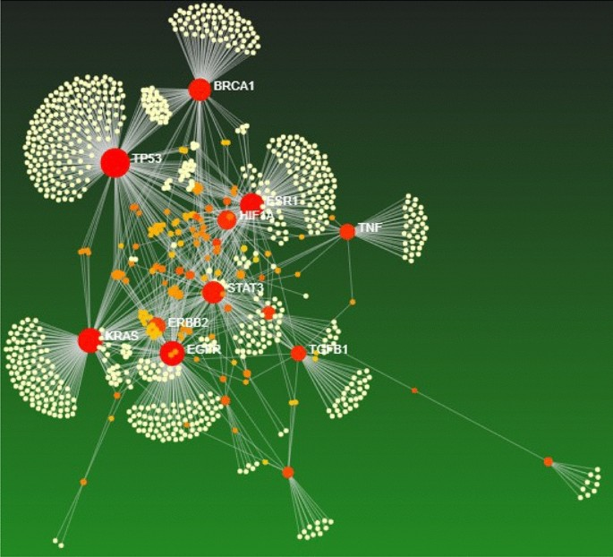
BIOLOGICAL NETWORKS:
How Graph Partitioning is Used: Used to identify clusters of proteins or genes that are functionally related. In bioinformatics, these partitions help in predicting protein functions and understanding biological pathways
Example: Protein-Protein Interaction (PPI) Networks use graph partitioning to identify protein complexes or functional modules involved in biological processes.

Slide 73

TRANSPORTATION NETWORKS:
How Graph Partitioning is Used: It divides a transportation network into smaller regions for efficient route planning and traffic management. This reduces computational complexity when calculating the shortest path.
Example: Google Maps uses graph partitioning techniques to efficiently compute optimal routes by dividing cities into regions and processing them separately for quicker responses.

Slide 74

IMAGE PROCCESSING:
How Graph Partitioning is Used: In image segmentation, graph partitioning divides an image into distinct regions or segments, where nodes represent pixels or superpixels, and edges represent the similarity between them. The goal is to group pixels that are similar in terms of color, texture, or intensity.
Example: Normalized Cuts Algorithm is used in image processing to partition an image into segments by minimizing the similarity between different segments while maximizing the similarity within the same segment.

Slide 75
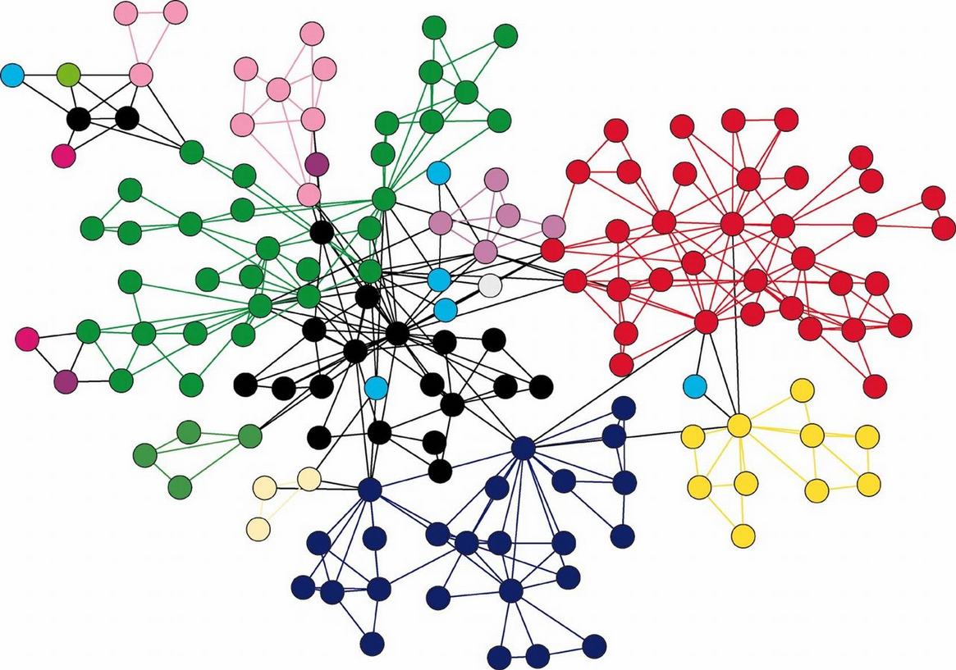
DATABASE MANAGEMENT:
How Graph Partitioning is Used: In distributed databases, graph partitioning divides data into smaller partitions that can be spread across multiple servers to improve query performance and reduce communication overhead between servers.
Example: Neo4j, a graph database, uses graph partitioning to distribute graph data across different servers, allowing for faster querying and load balancing in large-scale database systems. This helps in scenarios such as social network analysis or recommendation engines, where relationships between entities are important.

Slide 76
References:
Book: Graph Partitioning- Bicot and Siarry
https://www.sciencedirect.com/topics/computer-science/graph-partition-problem
Allow Me to Introduce Spectral and Isoperimetric Graph Partitioning - Jonathan Richard Shewchuk
Multilevel Graph Partitioning - George Karypis and Vipin Kumar
Paper: http://yoksis.bilkent.edu.tr/doi_getpdf/articles/10.1109-43.573831.pdf
https://www.worldscientific.com/doi/abs/10.1142/S021812669200012X
https://ieeexplore.ieee.org/abstract/document/508322

Slide 77

BANGLADESH UNIVERSITY OF ENGINEERING AND TECHNOLOGY
And we're done for the day!
ANY QUESTIONS?

